Slide 1

Examination Entry System
Group 9

Slide 2

Introduction
We have developed an Exam Entry System to simplify university examination entry applications.
The system enables students to apply for exams easily while allowing staff to verify eligibility based on attendance and discipline.
Facilitates exam attendance sheet generation and administrative oversight, ensuring a smooth and efficient exam admission process.
2020/ICT/64

Slide 3
Objectives
Digitize the exam registration process for students and administrators.
Improve the efficiency and accuracy of managing the applications for the exam admission by reducing the workload and time.
Minimize paperwork and manual errors.
Enhance security and data integrity.
Provide real-time status updates and notifications with deadlines.
2020/ICT/64

Slide 4
Requirements
Functional Requirements - General
User Authentication and Authorization
Able to reset password
2020/ICT/48

Slide 5
Requirements
Functional Requirements - User Based
Admin
Create users
Create batches and curriculums
Verify/update eligibility
Insert medical & resit students
Generate examination admission sheet & attendance sheet
Generate index numbers for students who do not have them
2.HOD & Dean
Update eligibility of students
View report
3.Lecturer in-charge
Update eligibility of students
4.Student
Apply for examination
Download Admission. (Temporarily disabled)
2020/ICT/48

Slide 6
Requirements
Non-Functional Requirements
Performance
Scalability
Security
Reliability
User-friendly
Maintainability
Data Integrity
Compliance
2020/ICT/101

Slide 7
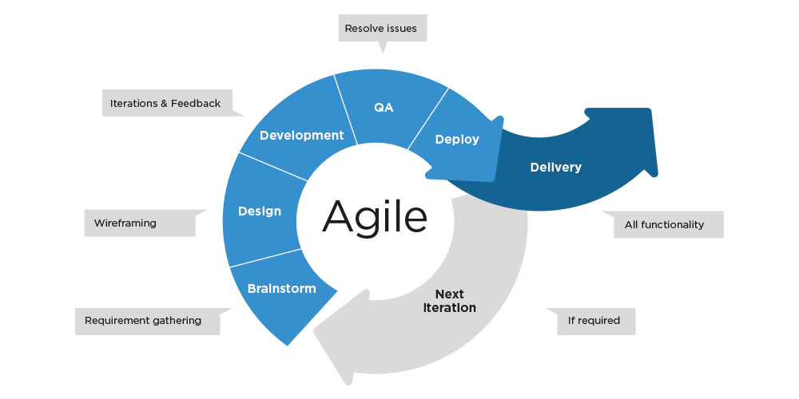
System Implementation
2020/ICT/18

Slide 8




Technology Used
Frontend: Next.js , Tailwind CSS
Backend: Node.js (Express)
Database: MySQL
Authentication: JWT JSON Web Tokens
Design Tools: Figma
2020/ICT/119

Slide 9
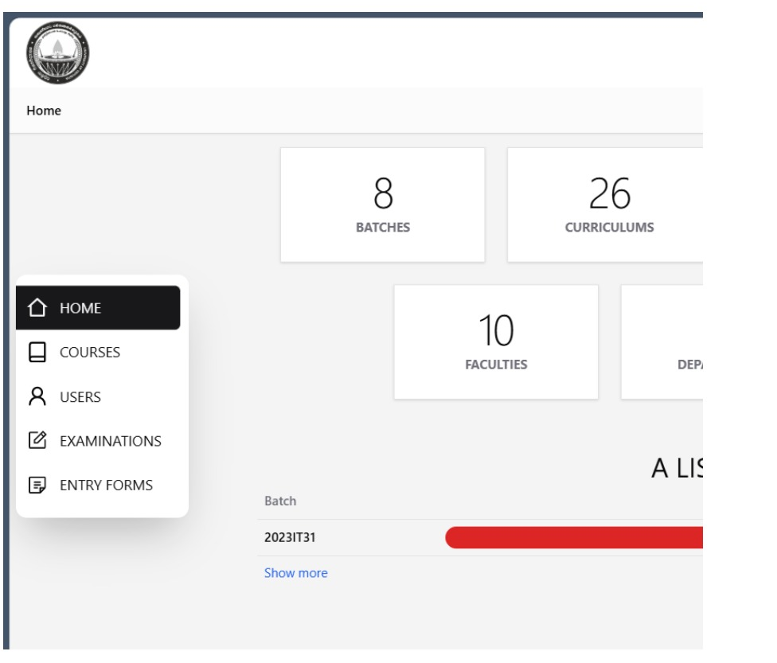
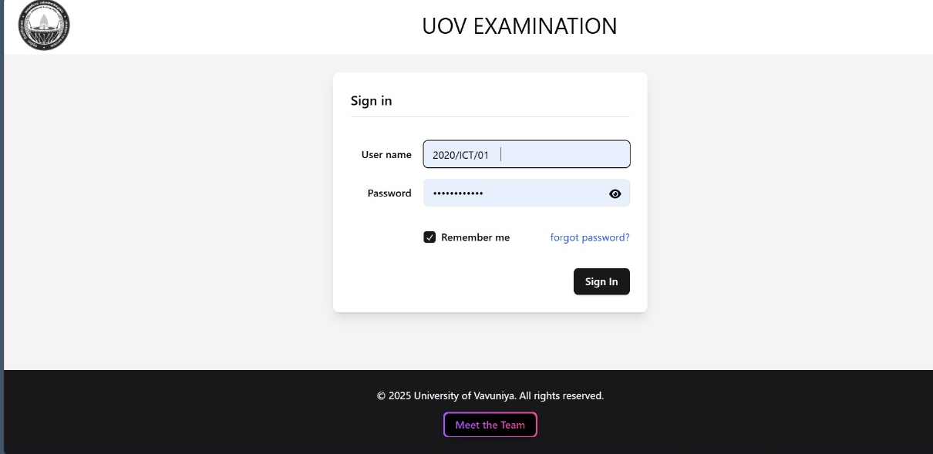
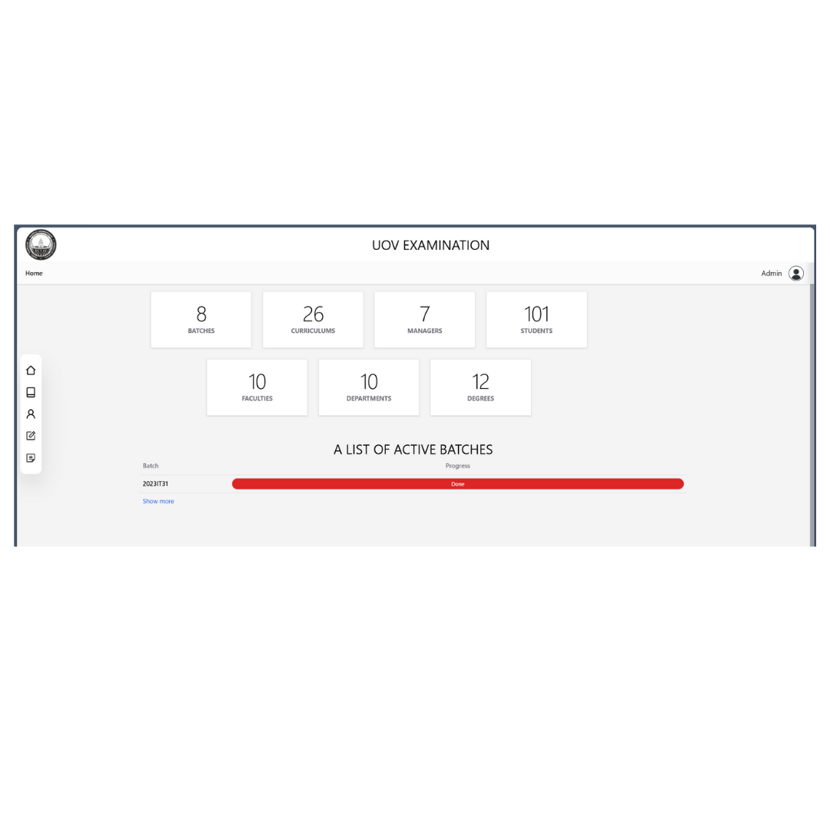
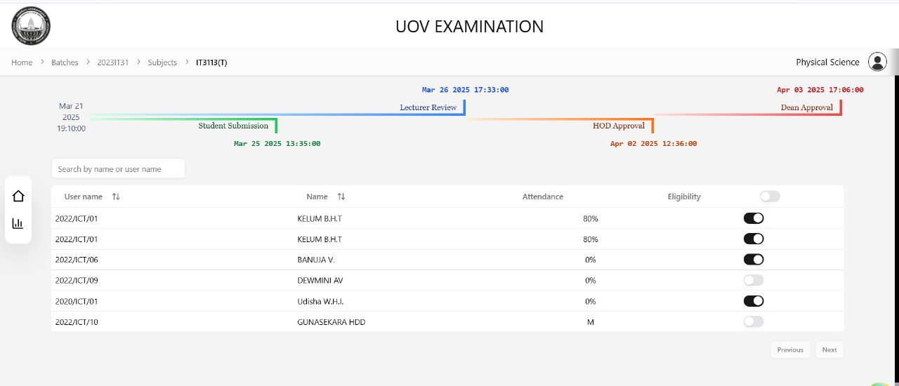
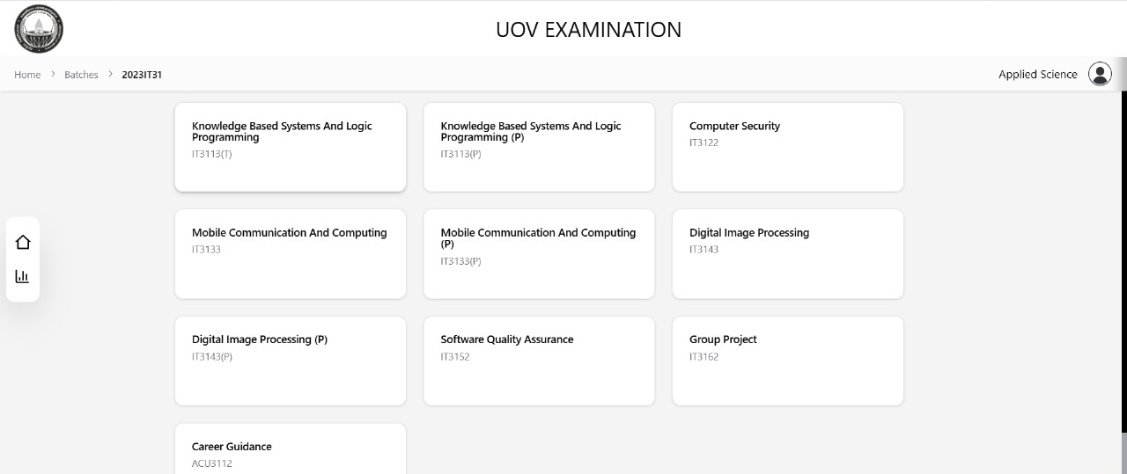
Interface

Slide 10
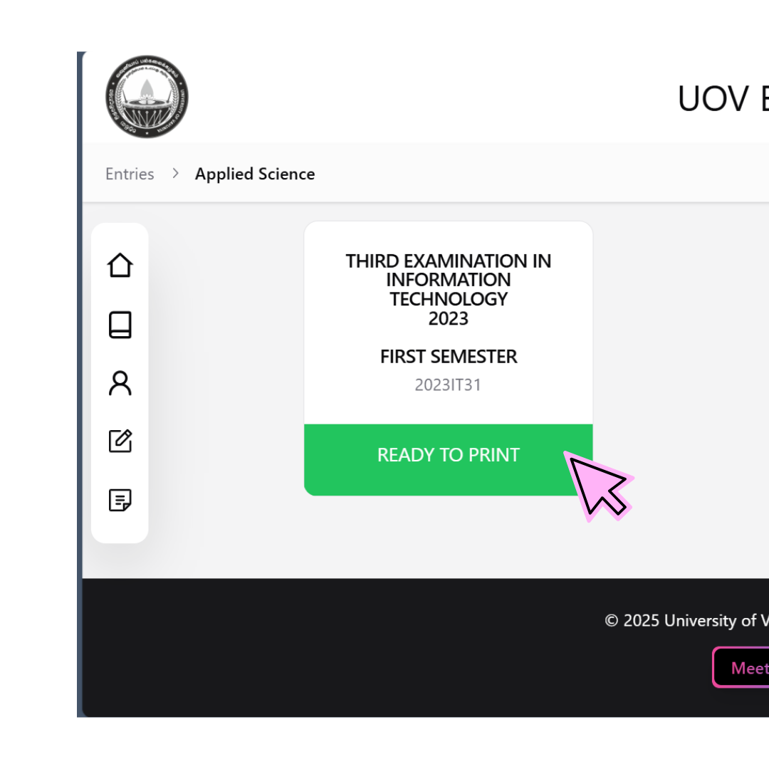
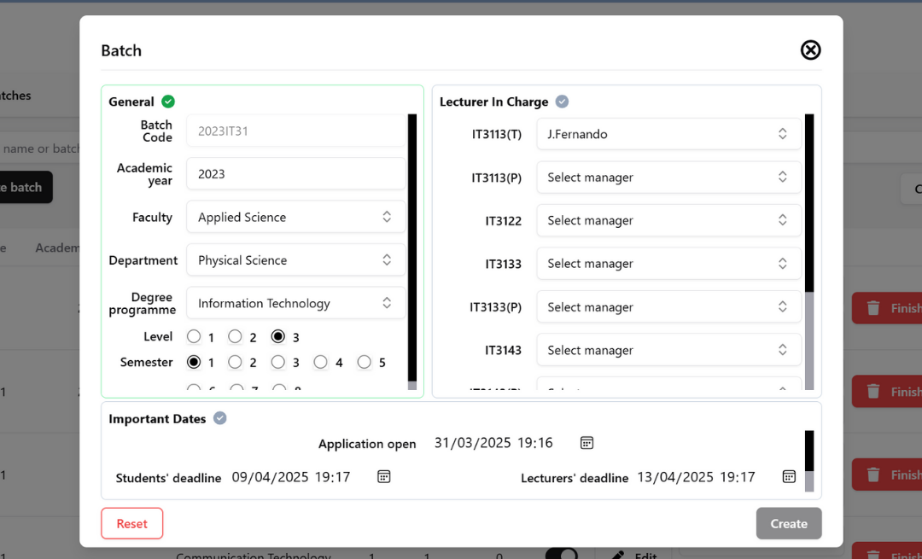
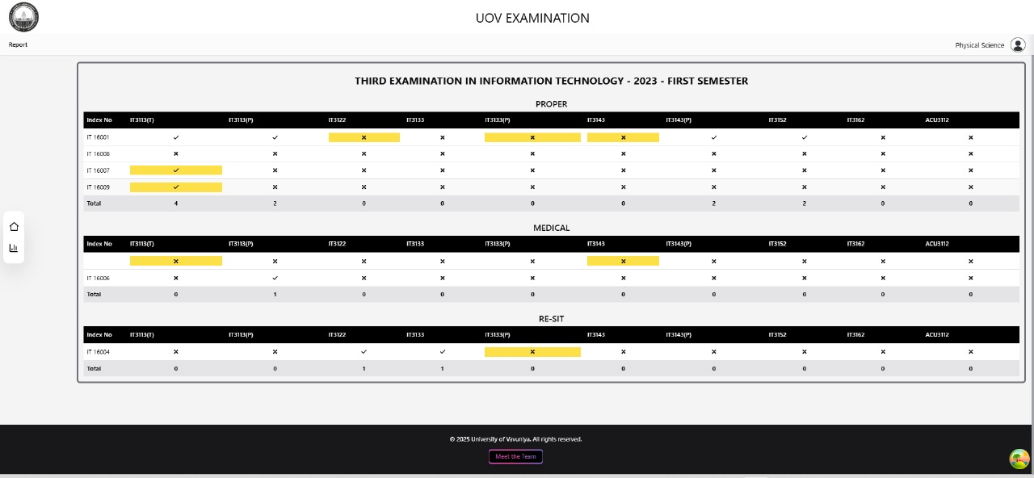
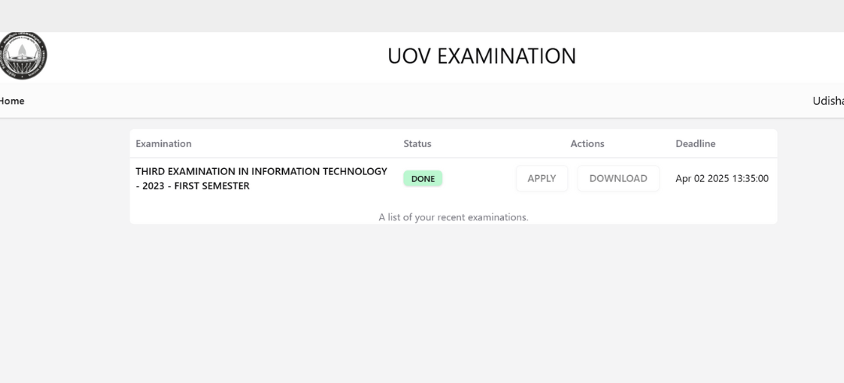
Interface

Slide 11
Advantages
Customizable.
Adaptability (To adapt any type of curriculums / degree programs.
Role based access levels and integrity.
Timeline alert and notifying e-mails.
Minimize human errors and paper works.
Reduced time.
User friendly.
2020/ICT/24

Slide 12
Limitation
Data accuracy and reliability that may occur due to input errors by the admin.
Internet dependency for real-time updates.
Consistent system maintenance and data backup requirements.
Potential security threats that require regular monitoring.
2020/ICT/24

Slide 13
Conclusion
The Exam Entry System streamlines the examination registration process by enhancing efficiency, security and accessibility for both students and administrators.
By reducing manual errors, computerizing eligibility verification and providing real-time updates, the system ensures a smoother and more reliable exam admission process.
To mitigate the challenges, continuous maintenance and monitoring will help, ensuring long-term success and usability.
2020/ICT/57

Slide 14


Any Questions?
Github link
Scan me!
https://github.com/SivaramalingamKirushanth/exm_entry

